Slide 1
GROUP 18
Aleksandra Kondracka
Thomas Cherry
Xiaofei Guo
Yi Luan
Kanlin Cheng
James Steeper

Slide 2
CO-FABRICO
Designers & Manufacturers
Opportunities
Range of Sectors
Web Development

Slide 3
SKILLS
HTML, CSS, JavaScript, PHP, mySQL
Web Development
Java Programming
Design Tools
Agile Development
Trello
Documentation
Collaborative Coding

Slide 4
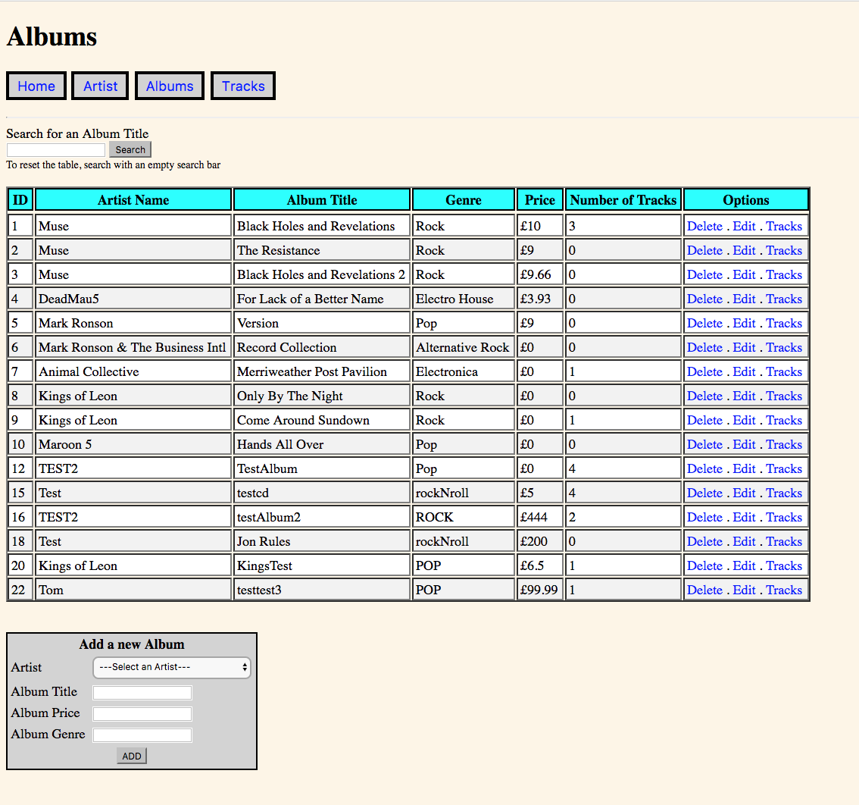
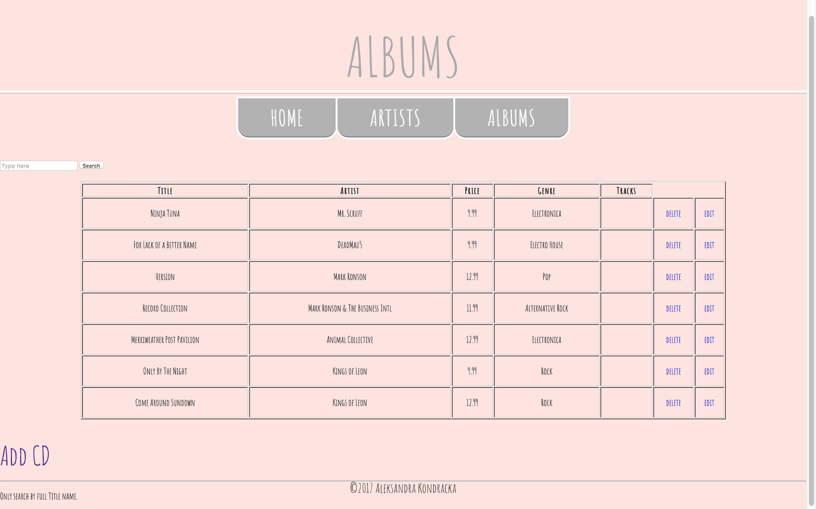

Slide 5
SKILLS
HTML, CSS, JavaScript, PHP, mySQL
Web Development
Java Programming
Design Tools
Agile Development
Trello
Documentation
Collaborative Coding

